Slide 1
Hate is Not Us
Stories from the Mid-City Campus

Slide 2
Stop the Hate/Hate is Not Us
Many countries, many cultures, many religions
All working and learning together
Safe and happy environment
How can we make it better

Slide 3
Adamu Auli
Coming to America was exciting but also hard for me. I was in the 7th grade and I could not speak English. I went to tutoring program where they helped me with my homework. The tutor used to drop off at home every day. One day, when we were going home, the tutor decided to stop at the park. Next thing I know she attacked me.

Slide 4
Adamu Auli
The next day when I went to school I found out that she told all the other tutors about the incident and the school found out. I felt very embarrassed and wanted to leave school. I even tried to do something bad so they would throw me out of school.
I felt vulnerable because I could not speak the English language and therefore I was a target of this humiliation. We must stop being hateful of other people because they are different. Being is different is what makes us unique.

Slide 5
Prince Shamamba
Came from Africa to the United Stated without speak English, was something that make me lonely; I couldn’t have friend or share what I have in me, everyone I was trying to make as a friend they just discriminate me, by asking me: you guys eat monkey, you guys sleep in a house, do you saw TV before? Go back to your country, your friend monkey miss you and too much.

Slide 6
Prince Shamamba
After all hate and discrimination I pass through, I sat down and realize that English is one of the big challenges for my life. I decide to go to school to learn and learn, now I am unstoppable guy and try to stop the hate for other people.

Slide 7
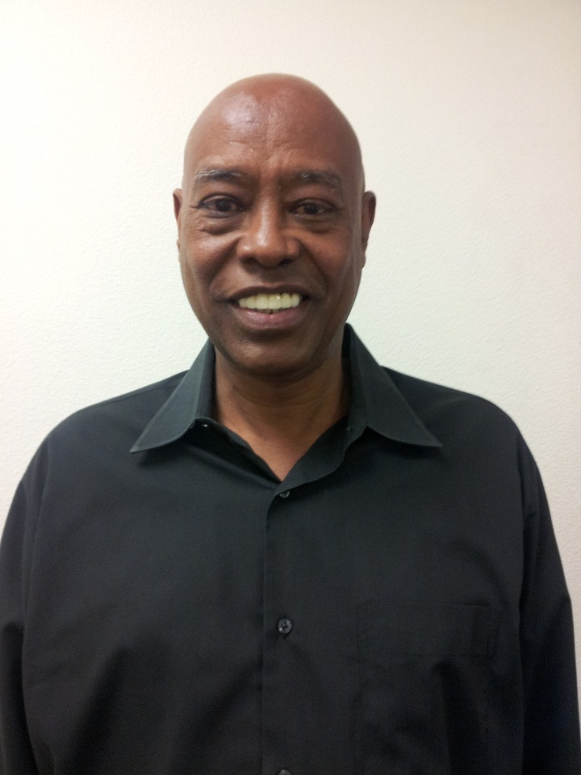
Salah Warsame
There was an incident that happened to our leaders (Sheikhs) on the east coast when they were traveling to a National Islamic Meeting. It was the time of prayer and they were praying inside the airport. Someone reported to the F.B.I. that some suspicious people were acting abnormal. The F.B.I. came and took to an undisclosed underground police station. One of the Sheikhs was blind and could not walk down the stairs. He asked the F.B.I. Agents to let him use an elevator because he was blind but they did not let him use the elevator because they thought he was acting.

Slide 8
Salah Warsame
After the interrogation was done and the sheikhs came out clean, the sheikhs asked the people who operated the airlines if they can continue on with their destination. They told them that they can’t board on the airplane and they can no longer fly with that airline.
As a result of this incident, the sheikhs sued the airline and were granted a settlement but did not get an apology for the incident that took place.

Slide 9
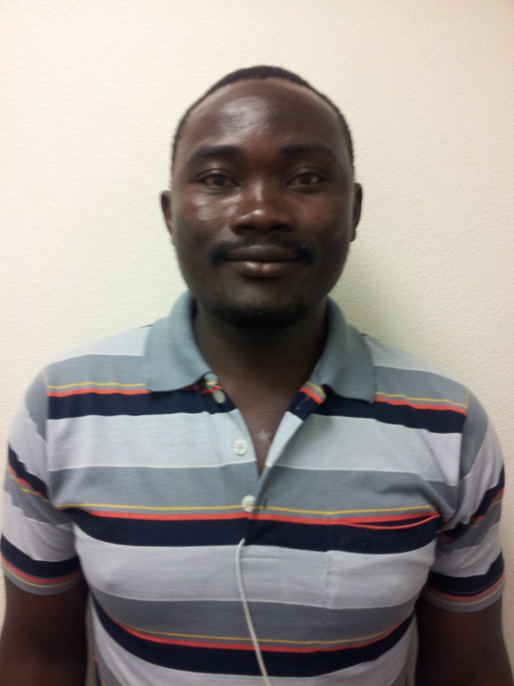
Tamogha Sapili
Last week when I came to school the automatic door entry was not working. As a person with a disability, it is important that the handicap access works properly. When it does not work, it is hard for students with disabilities to enter the school. I decided to fix the door so I could go to class. I feel that the school does not value students with disabilities who need such access. It is not our job to fix these things. Please help me to make sure the doors are working at all times.

Slide 10
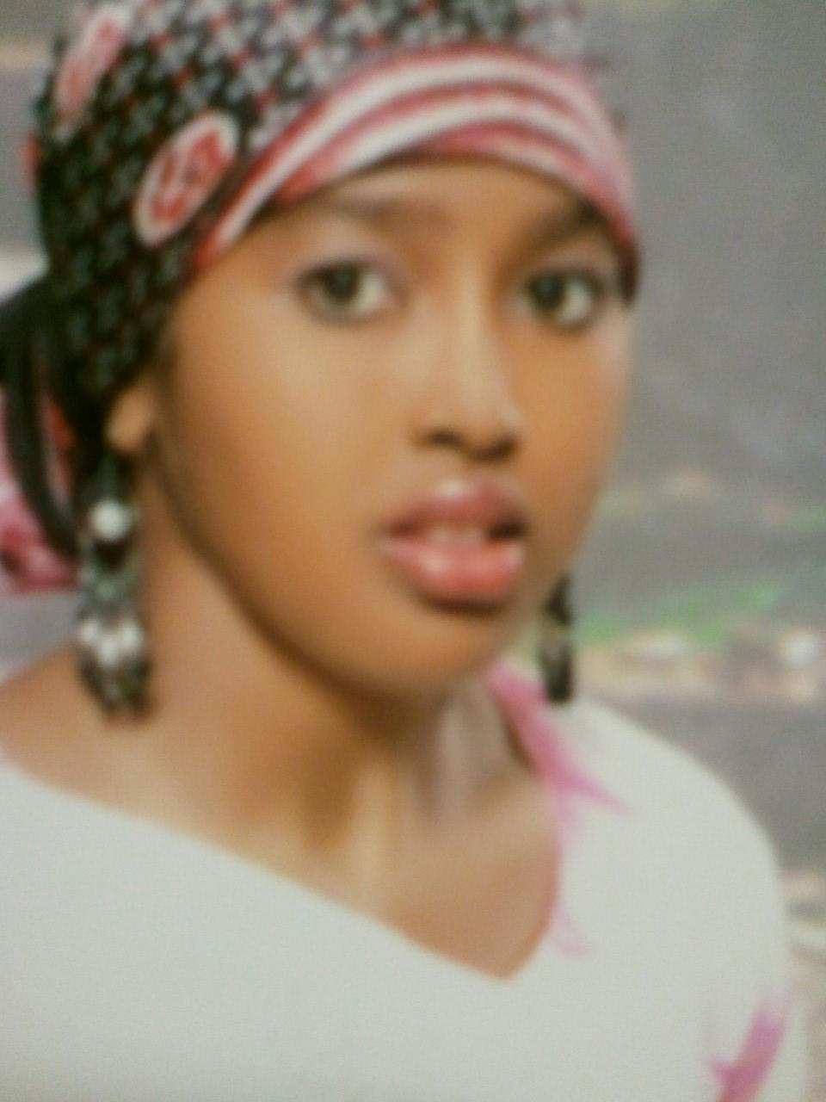
Idil Gabeyre
My name is Idil Gabeyre. I am Somalian-American. I was born in Somalia and I moved to the U.S. in 2004. In my short 9 years in the U.S., I have experienced hate and ignorance about my culture and religion. It is not okay for people to hate people and I hope that together we can stop the hate.
One time not long ago, I was on the bus and a man directed his anger at my friend and I for the way we were dressed. As part of my culture and religion, I wear clothes that cover up everything except for my face and hands. The man started yelling at us about our music being too loud. We answered “other people are listening to music on the bus, not us, so why do you have to be rude to us?” He then said, “I hate you people.”

Slide 11
Idil Gabeyre
It really hurt me to hear that man say those mean words because we did not do anything to him. I wish people would stop hating each other and start accepting each other. It is okay to be different and I believe that people should be judged based on kindness and good behavior and not because people wear different clothes or have different cultures or religion.

Slide 12
Nadia Abdi
While my kids and I were walking out of the hospital, I was looking for the bus station, the kid were very tired so I tried to ask a man he was near by me but he ran to his car and closed the window, while I'm trying to explain to him that I just want to know where I can find the bus.
The reason that this man was afraid of me because I am a black woman.

Slide 14
What can WE do?

Slide 15
Web Site
http://www.sdce.edu/organization/birt

Slide 16
Who sees it?
Vice President
Faculty
Staff

Slide 17
What happens?
Help (if you want)
Record
Classes

Slide 18
Questions?

